Slide 1
Mehran S. Fallah April 2020
Discrete Mathematics
Session VI
Generating Functions

Slide 2
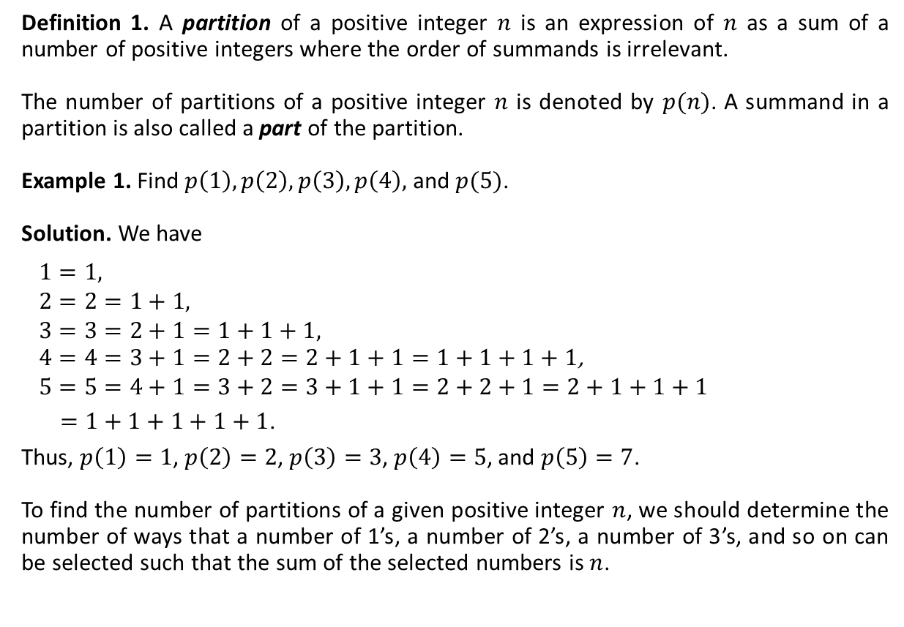
Partitions of Integers: Definition
Definition 1. A partition of a positive integer $n$ is an expression of $n$ as a sum of a number of positive integers where the order of summands is irrelevant.
The number of partitions of a positive integer $n$ is denoted by $p(n)$. A summand in a partition is also called a part of the partition.
Example 1. Find $p\left(1\right), p\left(2\right), p\left(3\right), p\left(4\right),$ and $p(5)$.
Solution. We have
$$1=1,$$
$$2=2=1+1,$$
$$3=3=2+1=1+1+1,$$
$4=4=3+1=2+2=2+1+1=1+1+1+1$,
$$5=5=4+1=3+2=3+1+1=2+2+1=2+1+1+1$$
$=1+1+1+1+1$.
Thus, $p\left(1\right)=1$, $p\left(2\right)=2$, $p\left(3\right)=3$, $p\left(4\right)=5$, and $p\left(5\right)=7$.
To find the number of partitions of a given positive integer $n$, we should determine the number of ways that a number of 1’s, a number of 2’s, a number of 3’s, and so on can be selected such that the sum of the selected numbers is $n$.

Slide 3
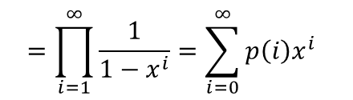
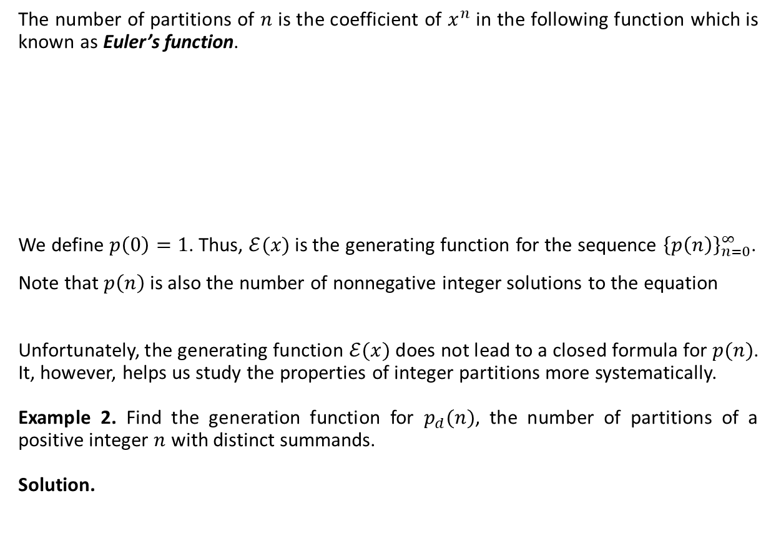


Partitions of Integers: Euler’s Function
The number of partitions of $n$ is the coefficient of $x^{n}$ in the following function which is known as Euler’s function.
We define $p\left(0\right)=1$. Thus, $ℰ(x)$ is the generating function for the sequence ${\left\{p\left(n\right)\right\}}_{n=0}^{∞}$.
Note that $p\left(n\right)$ is also the number of nonnegative integer solutions to the equation
Unfortunately, the generating function $ℰ(x)$ does not lead to a closed formula for $p(n)$. It, however, helps us study the properties of integer partitions more systematically.
Example 2. Find the generation function for $p_{d}(n)$, the number of partitions of a positive integer $n$ with distinct summands.
Solution.
$$ℰ\left(x\right)=\left(1+x+x^{2}+…\right)\left(1+x^{2}+x^{4}+…\right)\left(1+x^{3}+x^{6}+…\right)⋯$$
$$=\frac{1}{1−x}\frac{1}{1−x^{2}}\frac{1}{1−x^{3}}⋯$$
$$=\prod_{i=1}^{∞}{\frac{1}{1−x^{i}}}=\sum_{i=0}^{∞}{p\left(i\right)x^{i}}$$
$$x_{1}+2x_{2}+3x_{3}+…+nx_{n}=n.$$
$$\prod_{i=1}^{∞}{\left(1+x^{i}\right).}$$

Slide 4

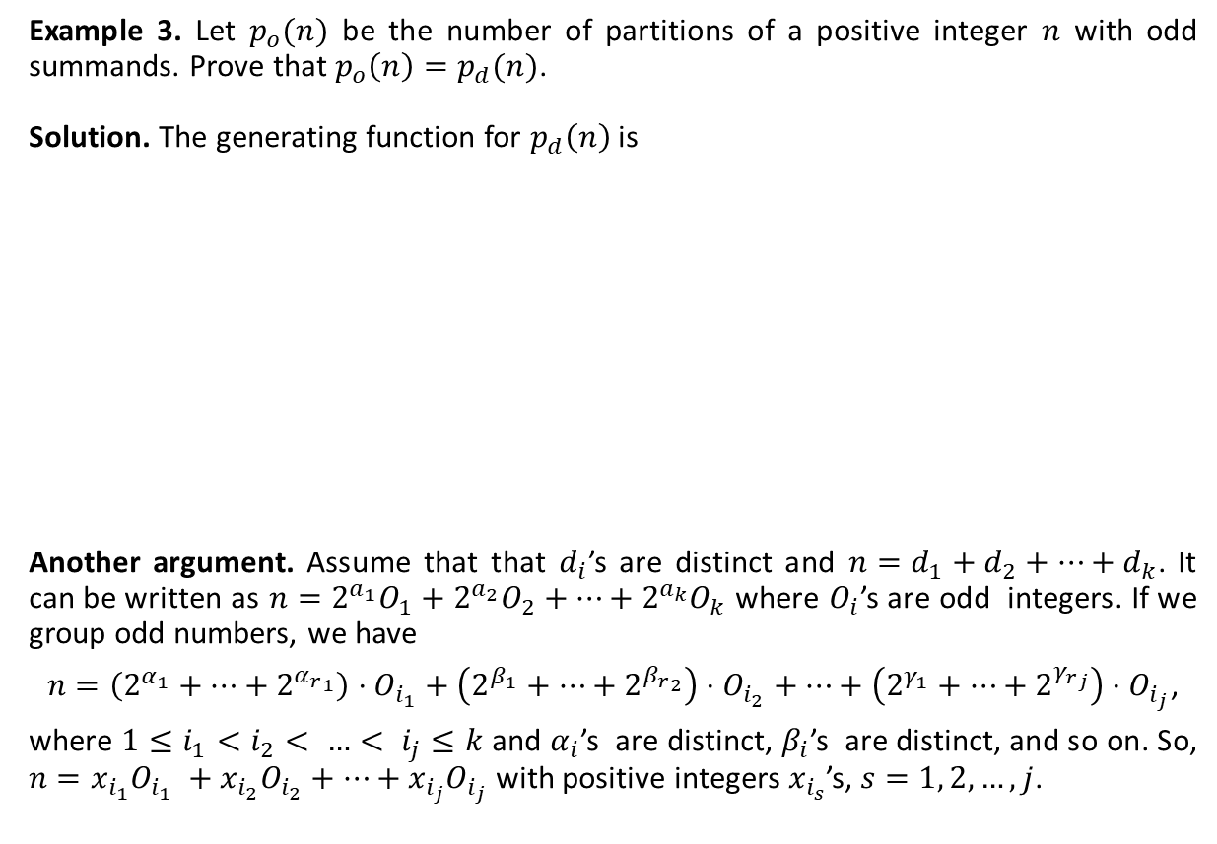


Partitions of Integers: Examples
Example 3. Let $p_{o}(n)$ be the number of partitions of a positive integer $n$ with odd summands. Prove that ${p_{o}\left(n\right)=p}_{d}(n)$.
Solution. The generating function for $p_{d}\left(n\right)$ is
Another argument. Assume that that $d_{i}$’s are distinct and $n=d_{1}+d_{2}+…+d_{k}$. It can be written as $n=2^{a_{1}}O_{1}+2^{a_{2}}O_{2}+…+2^{a_{k}}O_{k}$ where $O_{i}$’s are odd integers. If we group odd numbers, we have
$n=\left(2^{α_{1}}+…+2^{{α_{r}}_{1}}\right)⋅O_{i_{1}}+\left(2^{β_{1}}+…+2^{{β_{r}}_{2}}\right)⋅O_{i_{2}}+⋯+\left(2^{γ_{1}}+…+2^{{γ_{r}}_{j}}\right)⋅O_{i_{j}}$,
where ${1≤i}_{1}<i_{2}< …< i_{j}≤k$ and $α_{i}$’s are distinct, $β_{i}$’s are distinct, and so on. So, $n=x_{i_{1}}O_{i_{1}} +x_{i_{2}}O_{i_{2}}+…+x_{i_{j}}O_{i_{j}}$ with positive integers $x_{i_{s}}$’s, $s=1, 2, …,j$.
$$P_{d}\left(x\right)=\left(1+x\right)\left(1+x^{2}\right)\left(1+x^{3}\right)\left(1+x^{4}\right)⋯$$
$$=\frac{1−x^{2}}{1−x}\frac{1−x^{4}}{1−x^{2}}\frac{1−x^{6}}{1−x^{3}}\frac{1−x^{8}}{1−x^{4}}⋯$$
$$=\frac{1}{1−x}\frac{1}{1−x^{3}}\frac{1}{1−x^{5}}\frac{1}{1−x^{7}}⋯$$
$$=\left(1+x+x^{2}+…\right)\left(1+x^{3}+x^{6}+…\right)\left(1+x^{5}+x^{10}+…\right)⋯$$
$$=p_{o}(x)$$

Slide 5


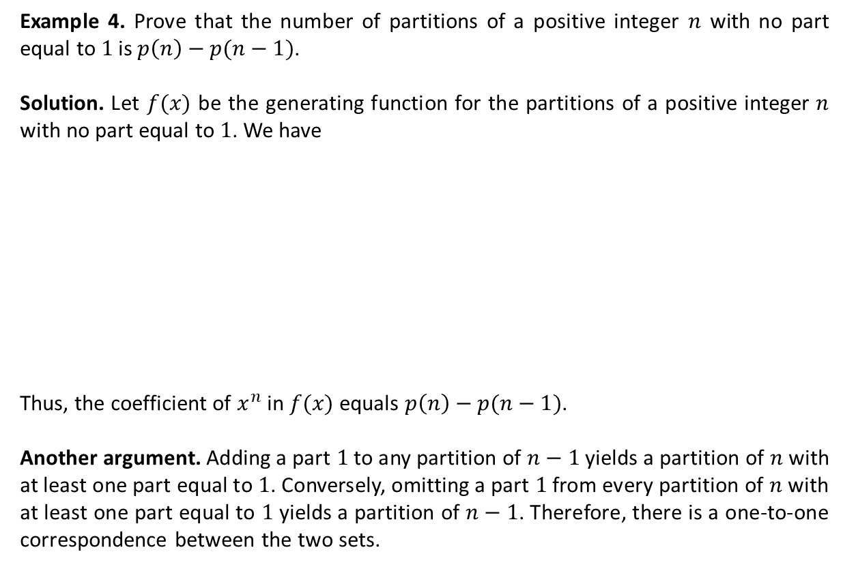

Partitions of Integers: Examples (Ctd.)
Example 4. Prove that the number of partitions of a positive integer $n$ with no part equal to $1$ is $p\left(n\right)−p(n−1)$.
Solution. Let $f(x)$ be the generating function for the partitions of a positive integer $n$ with no part equal to $1$. We have
Thus, the coefficient of $x^{n}$ in $f(x)$ equals $p\left(n\right)−p(n−1)$.
Another argument. Adding a part $1$ to any partition of $n−1$ yields a partition of $n$ with at least one part equal to $1$. Conversely, omitting a part $1$ from every partition of $n$ with at least one part equal to $1$ yields a partition of $n−1$. Therefore, there is a one-to-one correspondence between the two sets.
$$f(x)=\left(1+x^{2}+x^{4}+…\right)\left(1+x^{3}+x^{6}+…\right)\left(1+x^{4}+x^{8}+…\right)⋯$$
$$=\frac{1}{1−x^{2}}\frac{1}{1−x^{3}}\frac{1}{1−x^{4}}⋯$$
$$=\frac{1−x}{1−x}\frac{1}{1−x^{2}}\frac{1}{1−x^{3}}\frac{1}{1−x^{4}}⋯$$
$$=\left(1−x\right)ℰ\left(x\right)=\sum_{i=0}^{∞}{p\left(i\right)x^{i}}−\sum_{i=0}^{∞}{p\left(i\right)x^{i+1}}$$
$$=\sum_{i=0}^{∞}{p\left(i\right)x^{i}}−\sum_{i=1}^{∞}{p\left(i−1\right)x^{i}}=p\left(0\right)+\sum_{i=1}^{∞}{\left(p\left(i\right)−p(i−1)\right)x^{i}}$$

Slide 6

The Ferrers Diagram
A Ferrers diagram (graph) is a way for representing a partition of an integer using rows of dots where the number of dots in a row does not increases as we go to the row below it. The number of rows equals the number of parts of the partition, and the number of dots in a row represents the corresponding part.
The following are Ferrers diagrams for two of the partitions of $21$. The figure at the left represents the partition $6+4+3+2+2+2+1+1$ and the one at the right represents $8+6+3+2+1+1$. The graph at the right is to be the transposition of the graph at the left and vice versa, because one can be obtained from the other by interchanging rows and columns.
Can we deduce that the number of partitions with the largest part $k$ equals the number of partitions with $k$ parts?

Slide 7

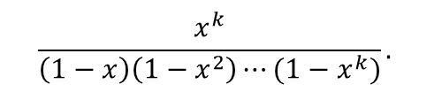


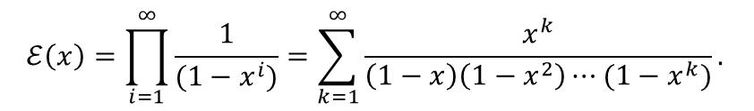
Partitions $p_{k}(n)$ and $p_{≤k}(n)$
Let $p_{k}(n)$ be the number of partitions of $n$ whose largest part is $k$. For example, $p_{2}\left(5\right)=2$, because the partitions of $5$ with the largest part $2$ are $2+2+1$ and $2+1+1+1$. Moreover, let $p_{≤k}(n)$ be the number of partitions of $n$ where no part is larger than $k$. The generating function for ${\left\{p_{≤k}\left(n\right)\right\}}_{n=0}^{∞}$ is
What is the generating function for the sequence ${\left\{p_{k}\left(n\right)\right\}}_{n=0}^{∞}$? The coefficient of $x^{n}$ in the generating function for the sequence ${\left\{p_{k}\left(n\right)\right\}}_{n=0}^{∞}$is $p_{≤k}\left(n−k\right)$, that is the coefficient of $x^{n−k}$, in the generating function for ${\left\{p_{≤k}\left(n\right)\right\}}_{n=0}^{∞}$. Thus, the generating function of ${\left\{p\left(n,k\right)\right\}}_{n=0}^{∞}$ is
We have $p\left(n\right)=\sum_{k=1}^{∞}{p_{k}(n)}$. Thus,
Therefore,
$$\frac{1}{\left(1−x\right)\left(1−x^{2}\right)⋯(1−x^{k})}.$$
$$\frac{x^{k}}{\left(1−x\right)\left(1−x^{2}\right)⋯(1−x^{k})}.$$
$$ℰ\left(x\right)=\sum_{n=0}^{∞}{p\left(n\right)x^{n}}=\sum_{n=0}^{∞}{\sum_{k=1}^{∞}{p_{k}\left(n\right)}x^{n}=}\sum_{k=1}^{∞}{\sum_{n=0}^{∞}{p_{k}\left(n\right)}x^{n}=}\sum_{k=1}^{∞}{\frac{x^{k}}{\left(1−x\right)\left(1−x^{2}\right)⋯(1−x^{k})}.}$$
$$ℰ\left(x\right)=\prod_{i=1}^{∞}{\frac{1}{(1−x^{i})}}=\sum_{k=1}^{∞}{\frac{x^{k}}{\left(1−x\right)\left(1−x^{2}\right)⋯(1−x^{k})}.}$$

Slide 8


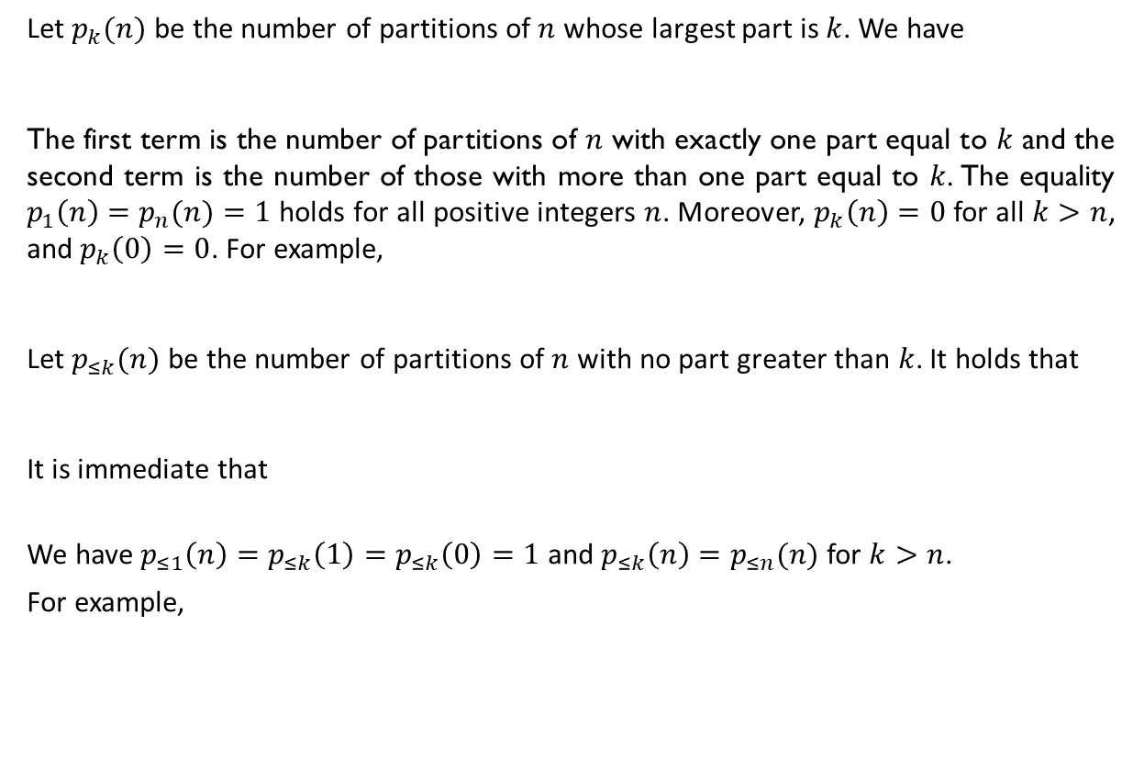

Some Recurrence Relations
Let $p_{k}(n)$ be the number of partitions of $n$ whose largest part is $k$. We have
The first term is the number of partitions of $n$ with exactly one part equal to $k$ and the second term is the number of those with more than one part equal to $k$. The equality $p_{1}\left(n\right)=p_{n}(n)=1$ holds for all positive integers $n$. Moreover, $p_{k}\left(n\right)=0$ for all $k>n$, and $p_{k}\left(0\right)=0$. For example,
Let $p_{≤k}(n)$ be the number of partitions of $n$ with no part greater than $k$. It holds that
It is immediate that
We have $p_{≤1}\left(n\right)=p_{≤k}\left(1\right)=p_{≤k}\left(0\right)=1$ and $p_{≤k}\left(n\right)=p_{≤n}(n)$ for $k>n$.
For example,
$$p_{k}\left(n\right)=p_{k−1}\left(n−1\right)+p_{k}\left(n−k\right).$$
$$p_{2}\left(5\right)=p_{1}\left(4\right)+p_{2}\left(3\right)=1+p_{1}\left(2\right)+p_{2}\left(1\right)=1+1+0=2.$$
$$p_{≤k}\left(n\right)=p_{≤k−1}\left(n\right)+p_{≤k}\left(n−k\right).$$
$$p\left(n\right)=p_{≤n}\left(n\right).$$
$$p_{≤3}\left(5\right)=p_{≤2}\left(5\right)+p_{≤3}\left(2\right)$$
$$=p_{≤1}\left(5\right)+p_{≤2}\left(3\right)+p_{≤2}\left(2\right)$$
$$=1+p_{≤1}\left(3\right)+p_{≤2}\left(1\right)+p_{≤1}\left(2\right)+p_{≤2}\left(0\right)$$
$$=1+1+1+1+1=5$$

Slide 9







Balls and Containers
Now, let’s get pack to the problem of putting (to distribute) $m$ objects (balls) into $n$ containers ($m≥n.)$ We have already established the results summarized in the following table.
Objects Are Distinct | Containers Are Distinct | Some Containers May Be Empty | Number of Distributions
Yes | Yes | Yes
Yes | Yes | No
Yes | No | Yes
Yes | No | No
No | Yes | Yes
No | Yes | No
$$n^{m}$$
$$n!S(m,n)$$
$$\sum_{i=1}^{n}{S(m,i)}$$
$$S(m,n)$$
$$\left(\begin{matrix}n+m−1 \\ m\end{matrix}\right)$$
$$\left(\begin{matrix}m−1 \\ n−1\end{matrix}\right)$$

Slide 10

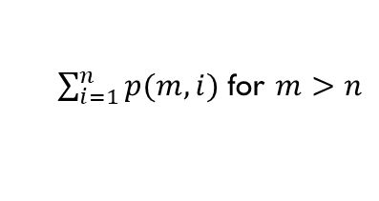



Balls and Containers (Ctd.)
Let $p(n,k)$ be the number of partitions of $n$ with $k$ parts. We know that
Consider the problem of balls and containers where the balls are indistinguishable and the containers are indistinguishable as well. The results are summarized in the following table.
$p\left(n,k\right)=p_{k}\left(n\right)$.
Objects Are Distinct | Containers Are Distinct | Some Containers May Be Empty | Number of Distributions
No | No | Yes
No | No | No
$p\left(m\right)$ for $m=n$
$\sum_{i=1}^{n}{p(m,i)}$ for $m>n$
$$p(m,n)$$

Slide 11
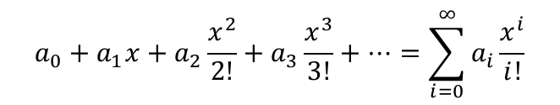
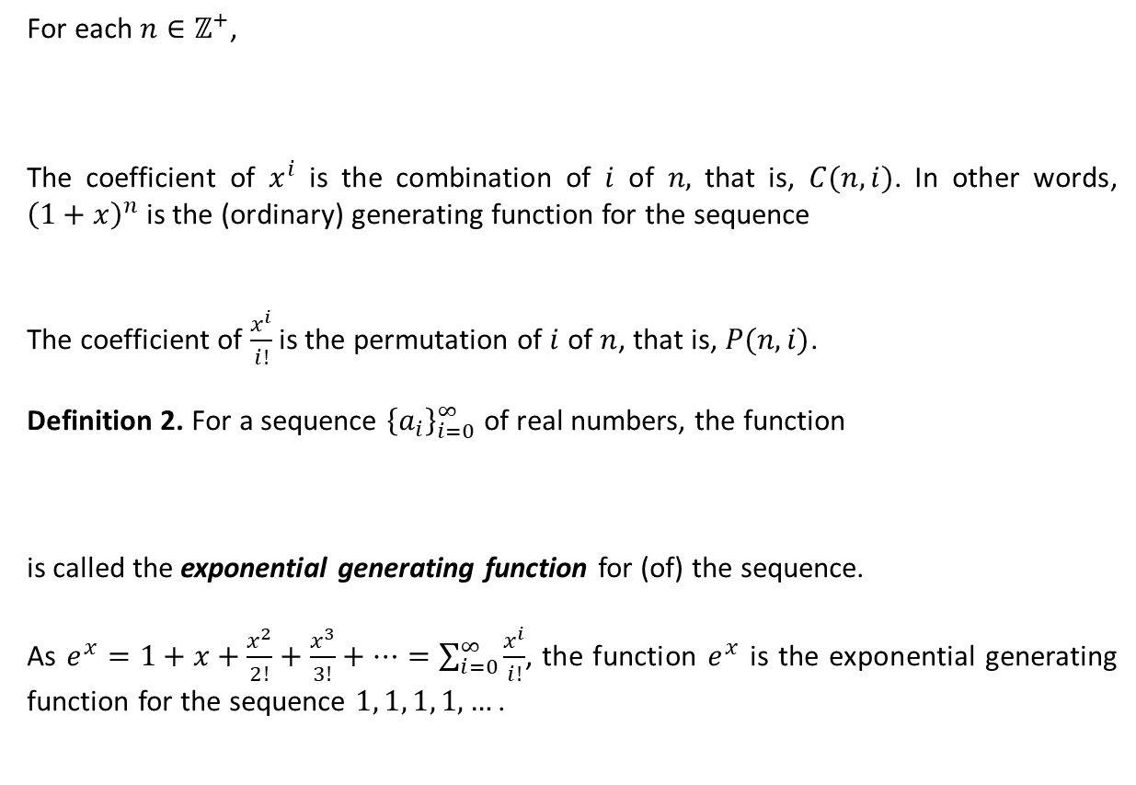
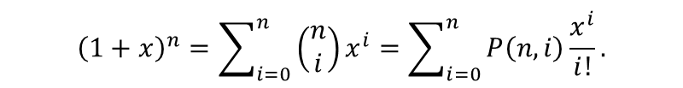
Exponential Generating Functions
For each $n∈ℤ^{+}$,
The coefficient of $x^{i}$ is the combination of $i$ of $n,$ that is, $C(n,i)$. In other words, ${\left(1+x\right)}^{n}$ is the (ordinary) generating function for the sequence
The coefficient of $\frac{x^{i}}{i!}$ is the permutation of $i$ of $n$, that is, $P(n,i)$.
Definition 2. For a sequence ${\left\{a_{i}\right\}}_{i=0}^{∞}$ of real numbers, the function
is called the exponential generating function for (of) the sequence.
As $e^{x}=1+x+\frac{x^{2}}{2!}+\frac{x^{3}}{3!}+…=\sum_{i=0}^{∞}{\frac{x^{i}}{i!}}$, the function $e^{x}$ is the exponential generating function for the sequence $1, 1, 1, 1, …$ .
$${\left(1+x\right)}^{n}=\sum_{i=0}^{n}{\left(\begin{matrix}n \\ i\end{matrix}\right)x^{i}}=\sum_{i=0}^{n}{P\left(n,i\right)\frac{x^{i}}{i!}}.$$
$$C\left(n,0\right), C\left(n,1\right), …, C\left(n,n\right), 0, 0, 0, ….$$
$$a_{0}+a_{1}x+a_{2}\frac{x^{2}}{2!}+a_{3}\frac{x^{3}}{3!}+…=\sum_{i=0}^{∞}{a_{i}}\frac{x^{i}}{i!}$$

Slide 12

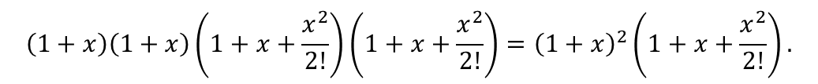
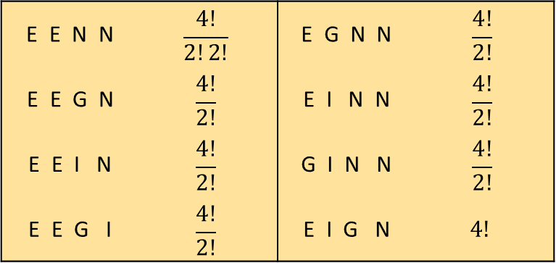
Applications
In how many ways can one order $4$ of the letters of ENGINE?
We have solved this problem using elementary techniques.
Now, consider the following expression.
The coefficient of $\frac{x^{4}}{4!}$ is the answer (the coefficient of $x^{4}$ multiplied by $4!$.)
E E N N | $$\frac{4!}{2!2!}$$ | E G N N | $$\frac{4!}{2!}$$
E E G N | $$\frac{4!}{2!}$$ | E I N N | $$\frac{4!}{2!}$$
E E I N | $$\frac{4!}{2!}$$ | G I N N | $$\frac{4!}{2!}$$
E E G I | $$\frac{4!}{2!}$$ | E I G N | $$4!$$
G
I
E
N
$$\left(1+x\right)\left(1+x\right)\left(1+x+\frac{x^{2}}{2!}\right)\left(1+x+\frac{x^{2}}{2!}\right)={\left(1+x\right)}^{2}\left(1+x+\frac{x^{2}}{2!}\right).$$

Slide 13






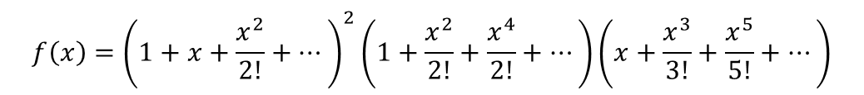
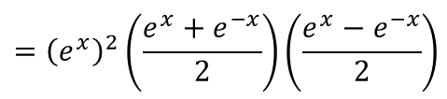

Applications
Consider the Maclaurin series of $e^{x}$ and $e^{−x}$.
Thus,
Example 5. A ship carries $48$ flags, $12$ each of the colors red, white, blue, and black. Twelve of these flags are placed on a vertical pole in order to communicate a signal to other ships. How many of these signals use an even number of blue flags and an odd number of black flags?
Solution. The answer is the coefficient of $\frac{x^{12}}{12!}$ in the following exponential generating function
The coefficient of $\frac{x^{12}}{12!}$ is $\frac{4^{12}}{4}=4^{11}$.
$$e^{x}=1+x+\frac{x^{2}}{2!}+\frac{x^{3}}{3!}+…$$
$$e^{−x}=1−x+\frac{x^{2}}{2!}−\frac{x^{3}}{3!}+…$$
$$\frac{e^{x}+e^{−x}}{2}=1+\frac{x^{2}}{2!}+\frac{x^{4}}{4!}+…$$
$$\frac{e^{x}−e^{−x}}{2}=x+\frac{x^{3}}{3!}+\frac{x^{5}}{5!}+…$$
$${f\left(x\right)=\left(1+x+\frac{x^{2}}{2!}+…\right)}^{2}\left(1+\frac{x^{2}}{2!}+\frac{x^{4}}{2!}+…\right)\left(x+\frac{x^{3}}{3!}+\frac{x^{5}}{5!}+…\right)$$
$$={\left(e^{x}\right)}^{2}\left(\frac{e^{x}+e^{−x}}{2}\right)\left(\frac{e^{x}−e^{−x}}{2}\right)$$
$$=\left(\frac{1}{4}\right){(e}^{4x}−1)$$
$$=\left(\frac{1}{4}\right)\sum_{i=1}^{∞}{\frac{{\left(4x\right)}^{i}}{i!}}$$

Slide 14
Textbook: Ralph P. Grimaldi, Discrete and Combinatorial Mathematics
Do exercises of Chapter 9 as homework and upload your solutions via Moodle (follow the instructions on the page of the TA of this course.)

